Slide 1
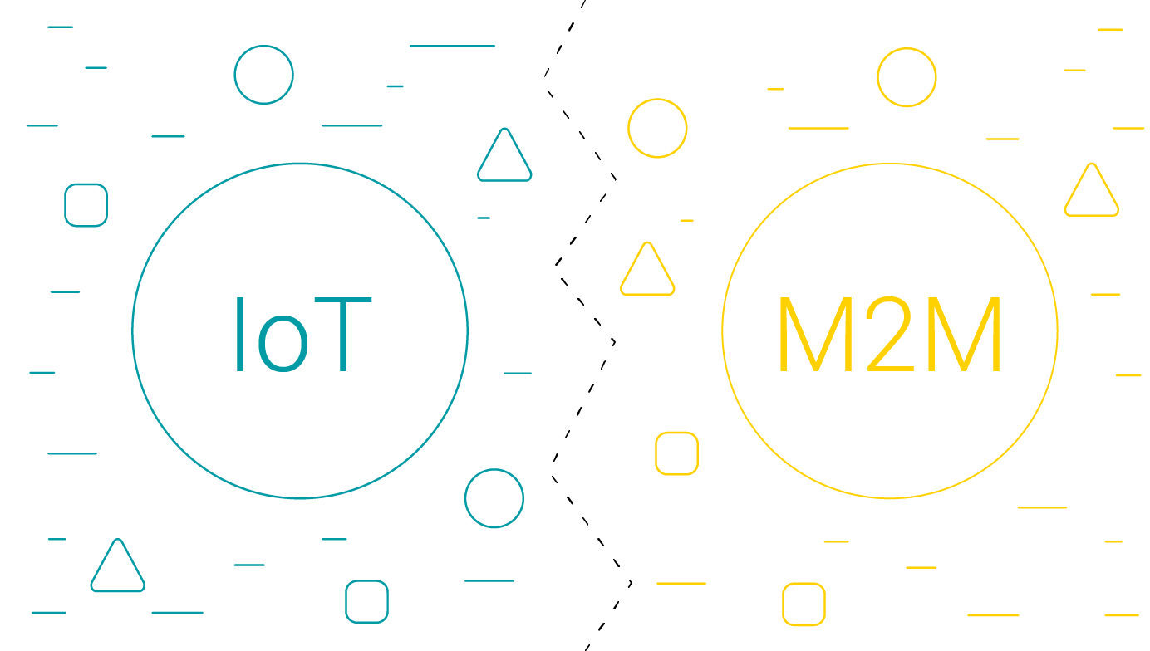
IOT & M2M

Slide 2
Outline
M2M
Differences and Similarities between M2M and IoT

Slide 3
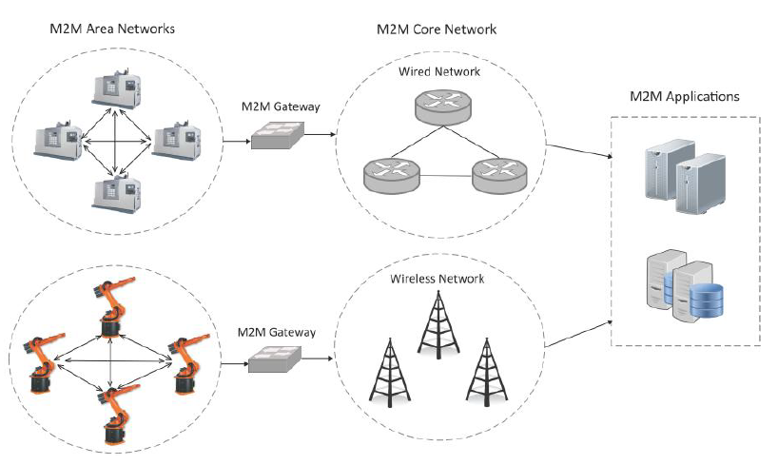
Machine-to-Machine (M2M)
Machine-to-Machine (M2M) refers to networking of machines (or devices) for the purpose of remote monitoring and control and data exchange.

Slide 4
Machine-to-Machine (M2M)
An M2M area network comprises of machines (or M2M nodes) which have embedded hardware modules for sensing, actuation and communication.
Various communication protocols can be used for M2M local area networks such as ZigBee, Bluetooh, ModBus, M-Bus, Wirless M-Bus, Power Line communication (PLC), 6LoWPAN, IEEE 802.15.4, etc.
The communication network provides connectivity to remote M2M area networks.
The communication network can use either wired or wireless networks (IPbased).
While the M2M area networks use either proprietary or non-IP based communication protocols, the communication network uses IP-based networks.

Slide 5
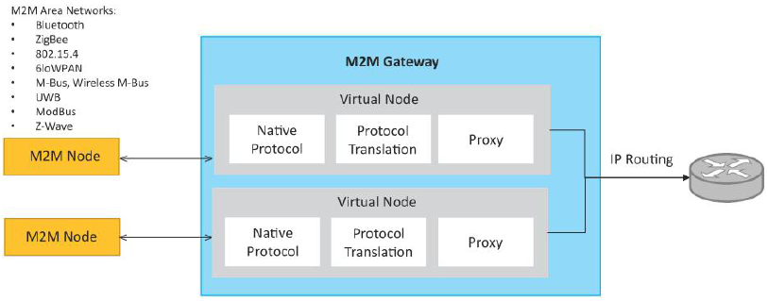
M2M gateway
Since non-IP based protocols are used within M2M area networks, the M2M nodes within one network cannot communicate with nodes in an external network.
To enable the communication between remote M2M area networks,M2M gateways are used.

Slide 6
Difference between IoT and M2M
Hardware vs Software Emphasis
While the emphasis of M2M is more on hardware with embedded modules, the emphasis of IoT is more on software.
Data Collection & Analysis
M2M data is collected in point solutions and often in on-premises storage infrastructure.
In contrast to M2M, the data in IoT is collected in the cloud (can be public, private or hybrid cloud).
Applications
M2M data is collected in point solutions and can be accessed by on-premises applications such as diagnosis applications, service management applications, and on premises enterprise applications.
IoT data is collected in the cloud and can be accessed by cloud applications such as analytics applications, enterprise applications, remote diagnosis and management applications, etc.

Slide 7
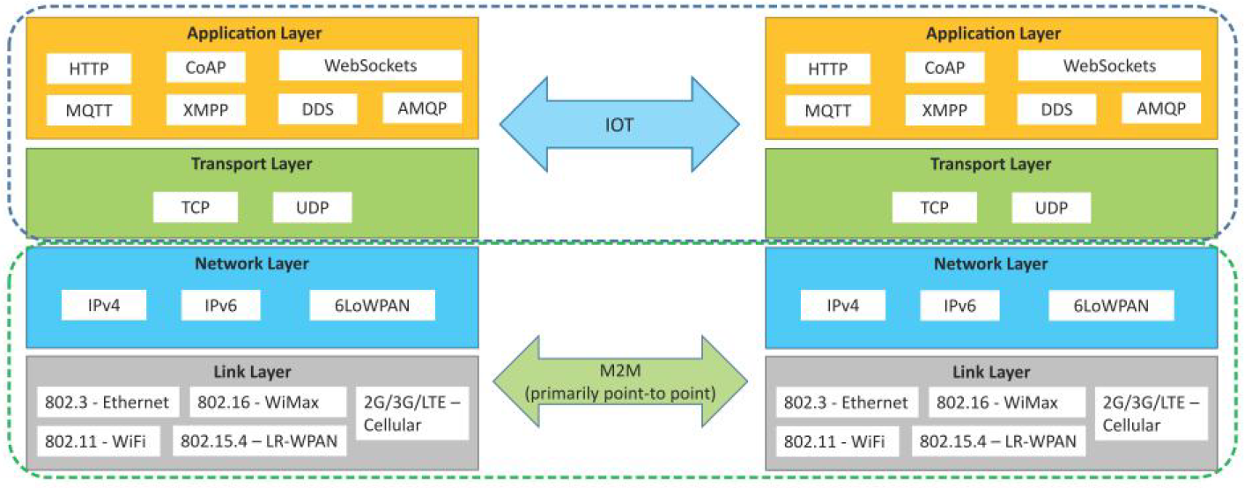
Communication in IoT vs M2M

Slide 8
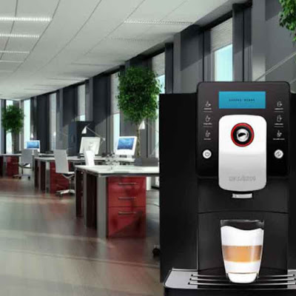
Example:M2M vs IoT
Lets take an example of an office with 3 floors. Lets assume that each floor has a coffee machine like the one in this picture or something similar.
Lets assume different scenarios:

Slide 9

Example:M2M vs IoT
Scenario 1: No connectivity
In this case a facilities person has to manually go to each of the floor and check if there are enough coffee beans, chocolate powder, milk powder, etc. He/She may have to do this say 3-4 times a day.

Slide 10
Example:M2M vs IoT
Scenario 2: Basic connectivity (M2M)
Lets say the coffee machine has basic sensors so it can send some kind of notification (on your phone or email or message, etc.) whenever the coffee beans, chocolate powder, milk powder, etc., falls below a certain level.
In some cases you may also be able to check the levels using some kind of a app on your phone or computer. This is an example of M2M

Slide 11
Example:M2M vs IoT
Scenario 3: Advanced connectivity (IoT)
Lets say that the coffee machine is connected to the office system and database.
It knows which employees come when and what is their coffee/drinks consumption pattern.
This way the machine can optimize when it needs to be topped up.
If there is a large meeting/event going on, the coffee machine can even check before the breaks and indicate in advance that it needs topping up with beans/chocolate/milk/etc.

Slide 12
Example:M2M vs IoT
Scenario 4: Intelligent Devices (Advanced IoT)
If we take the coffee machine from scenario 3 and add intelligence to it, it can even know about the inventory.
How much of coffee beans, chocolate powder, milk powder, etc is in stock and when would they need ordering again.
It can have an employee UI (User Interface) that can be used by employees to give feedback on which coffee beans are more/less popular or what drinks are popular.
This info can be used by the machines to order the supplies, taking into account the price, availability, etc.

Slide 13
Example:M2M vs IoT
With the current M2M, we have:
Connectivity: connection for machines;
Content: massive raw data from things;
With evolution to IoT, we have:
Cloud: cloud service and XaaS (Everything as a Service) for IoT;
Context: context-aware design;
Collaboration: collaborative services;
Cognition: semantics and autonomous system adjustment

Slide 14
References
https://www.youtube.com/watch?v=BqKZKvFgv1U

